Slide 1

RAVI RAJ KUMAR PATNAIK
A Web Developer Intern at Code Clause

Slide 2
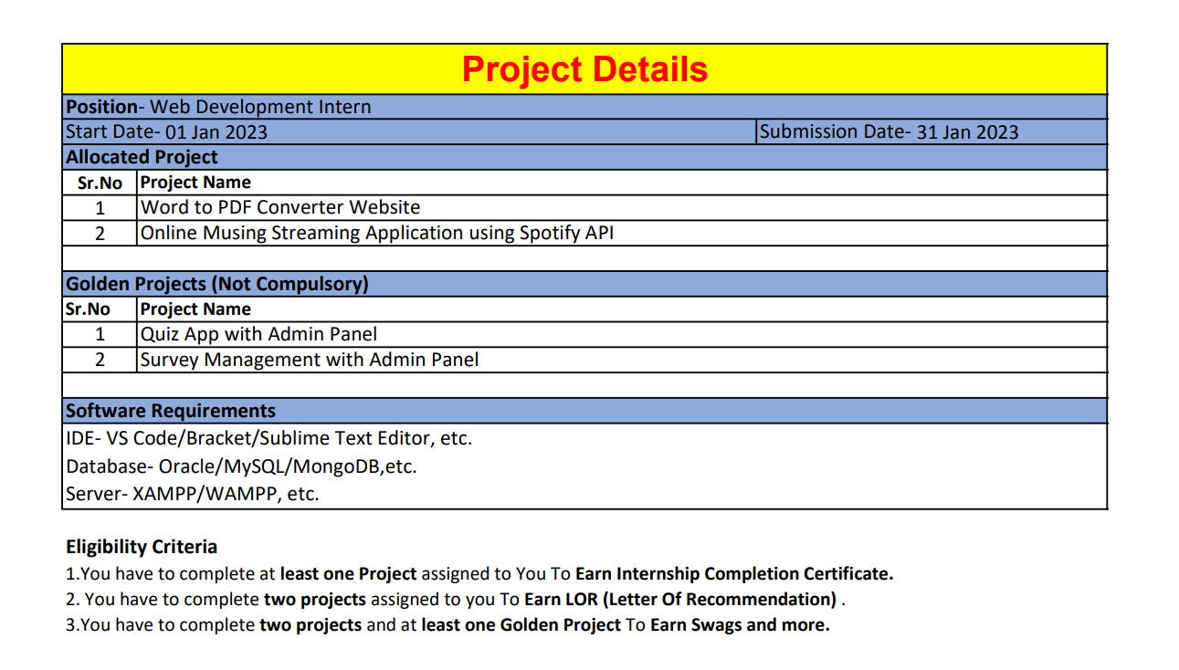

Slide 3

GOLDEN PROJECT

